Slide 1

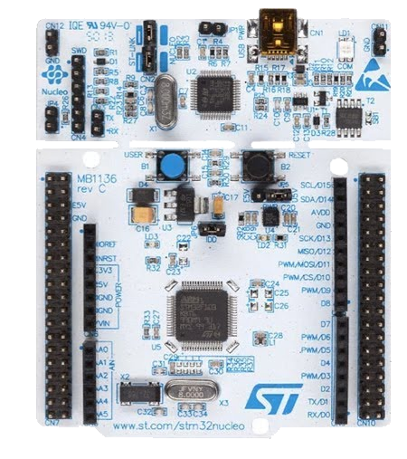
Micro-Controller Programming Overview
Hardware and Software
Micro-Controller vs Micro-Processor
Clock Overview

Slide 2
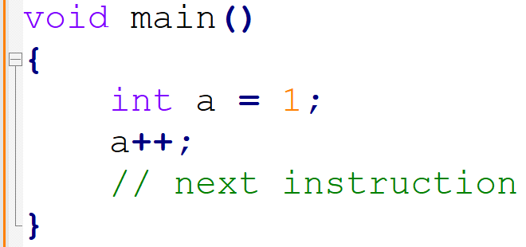
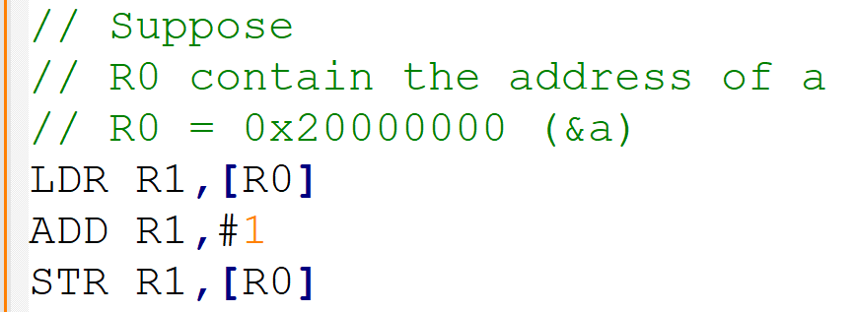
Micro-Processor Overview
How processor can execute the C program?
C Code
ASM Code

Slide 3
Micro-Processor Overview
Memory
int a = 1;
Micro-Processor
Value | Address
1 | 0x20000000
ALU
R0 | 0x20000000
R1
Register
2
1
Data Bus
2
LDR R1,[R0]
Control Unit
ADD R1,#1
STR R1,[R0]

Slide 4
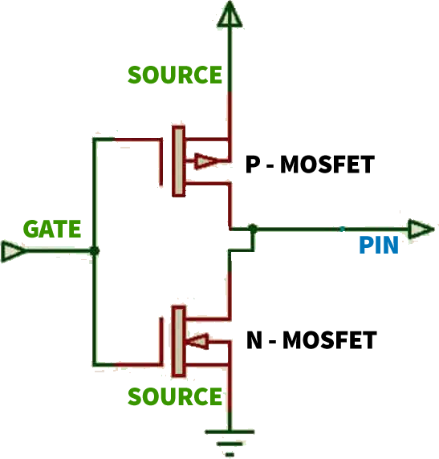
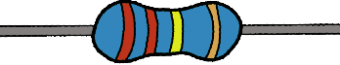
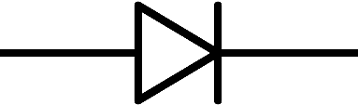

How Micro-Processor to control a LED?
Memory
Micro-Processor
Value | Address
ALU
R0
R1
Register
Bus
Control Unit

Slide 5
How Micro-Processor to control a LED?
Memory
Micro-Processor
Value | Address
0/1 | GPIO Register
ALU
R0
R1
Register
Bus
Control Unit

Slide 6
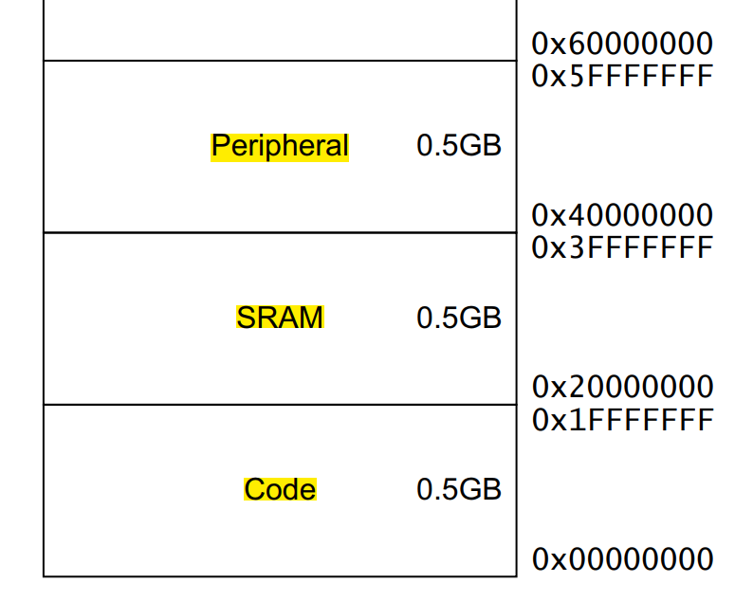
Peripheral = Memory (Register) + Circuit
Memory
Programable
Value | Address
0/1 | GPIO Register
Fixed
Circuit

Slide 7

AUTOMAION Engineer and control

